Slide 1

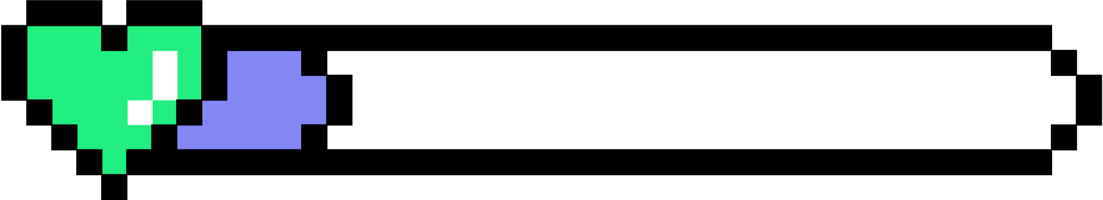
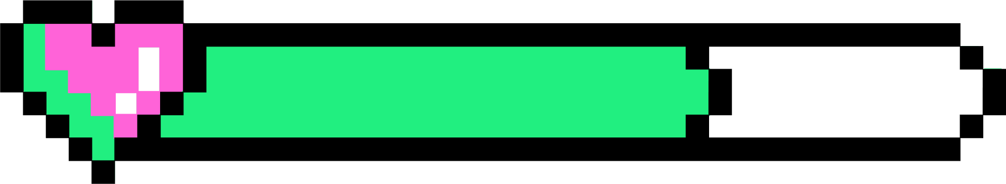

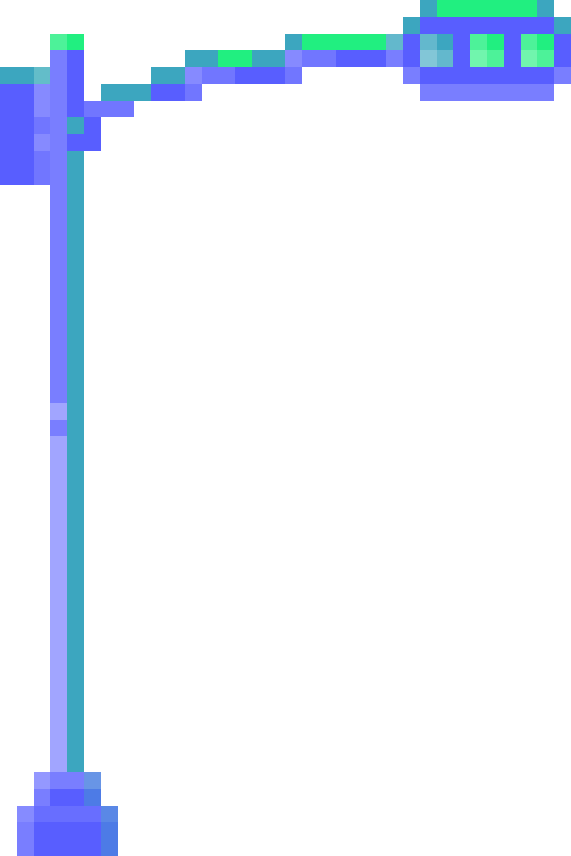
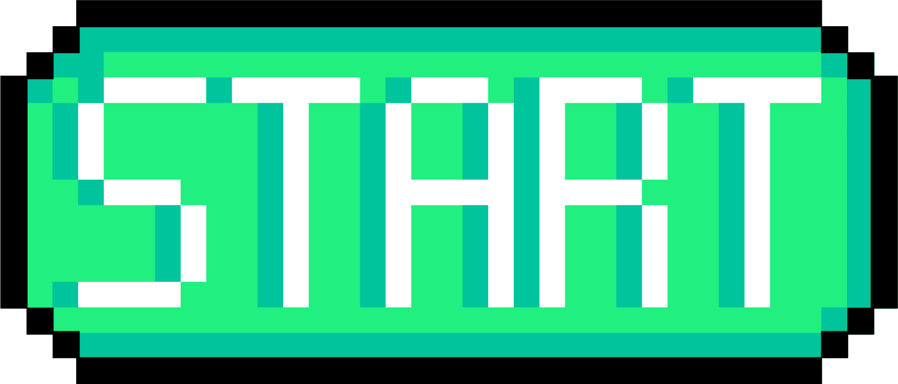



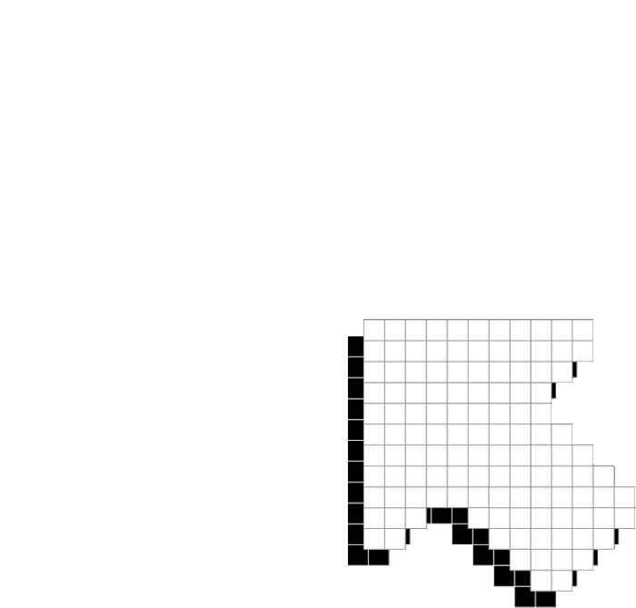
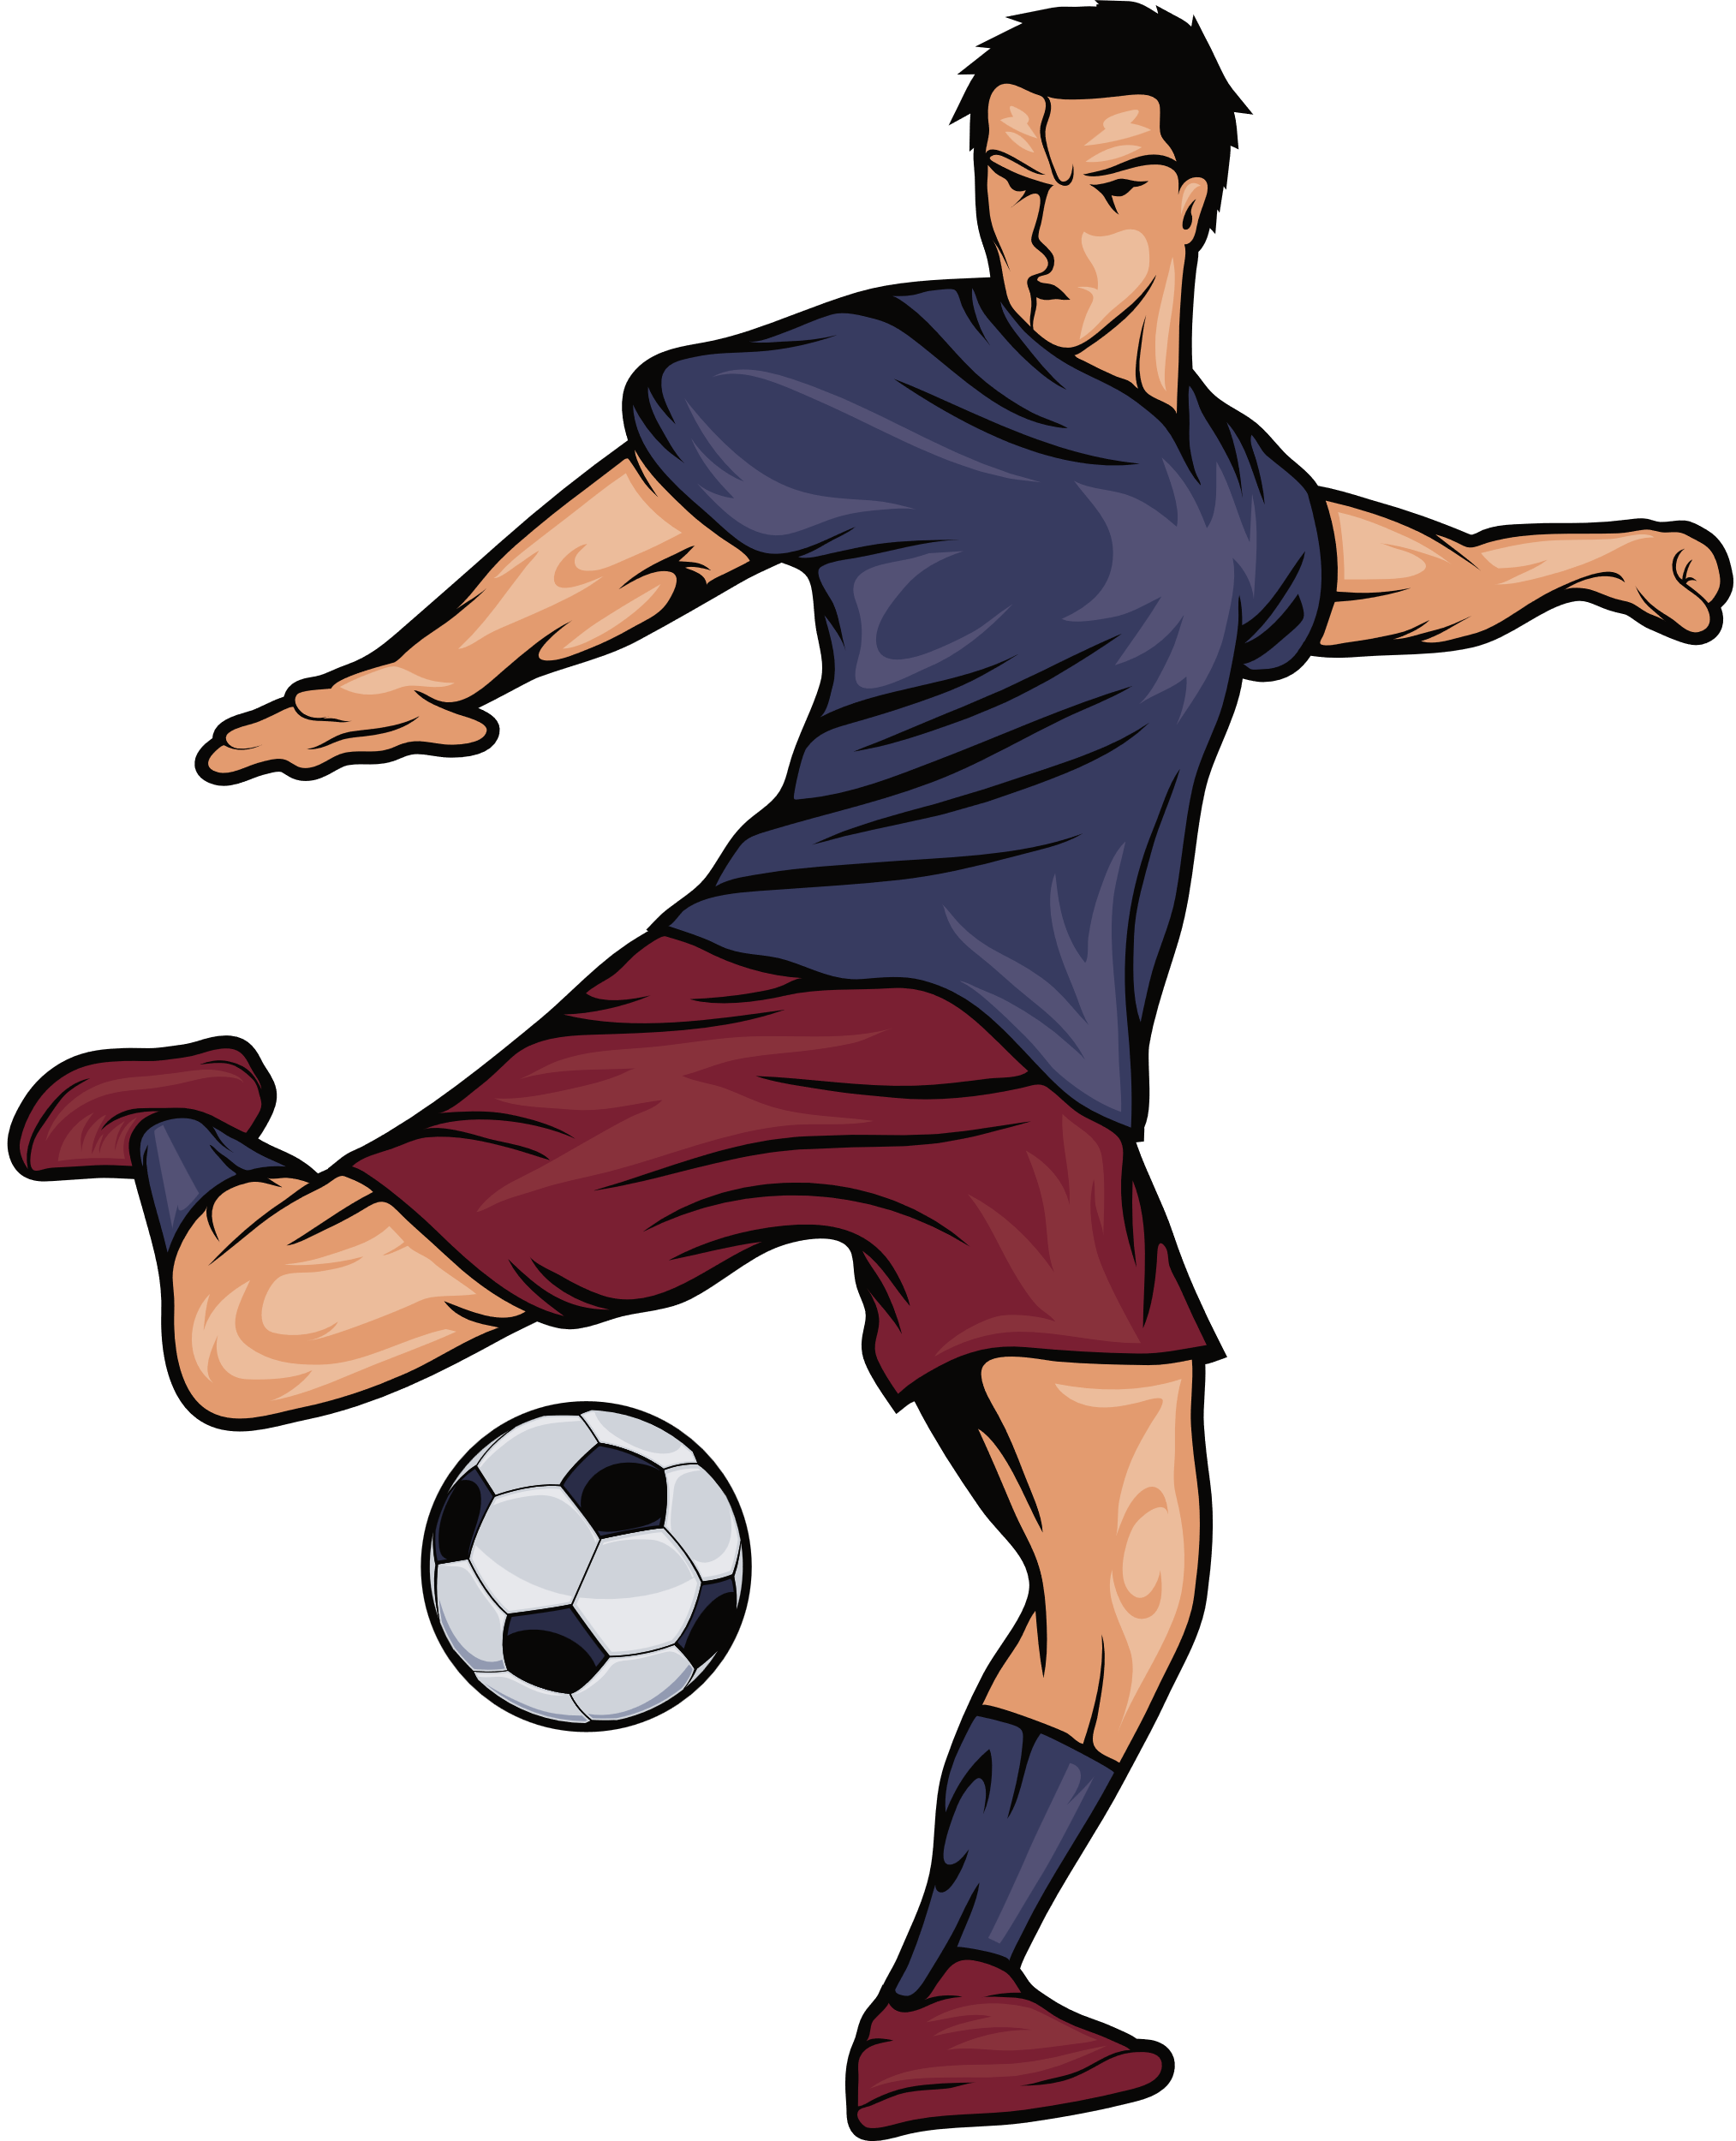
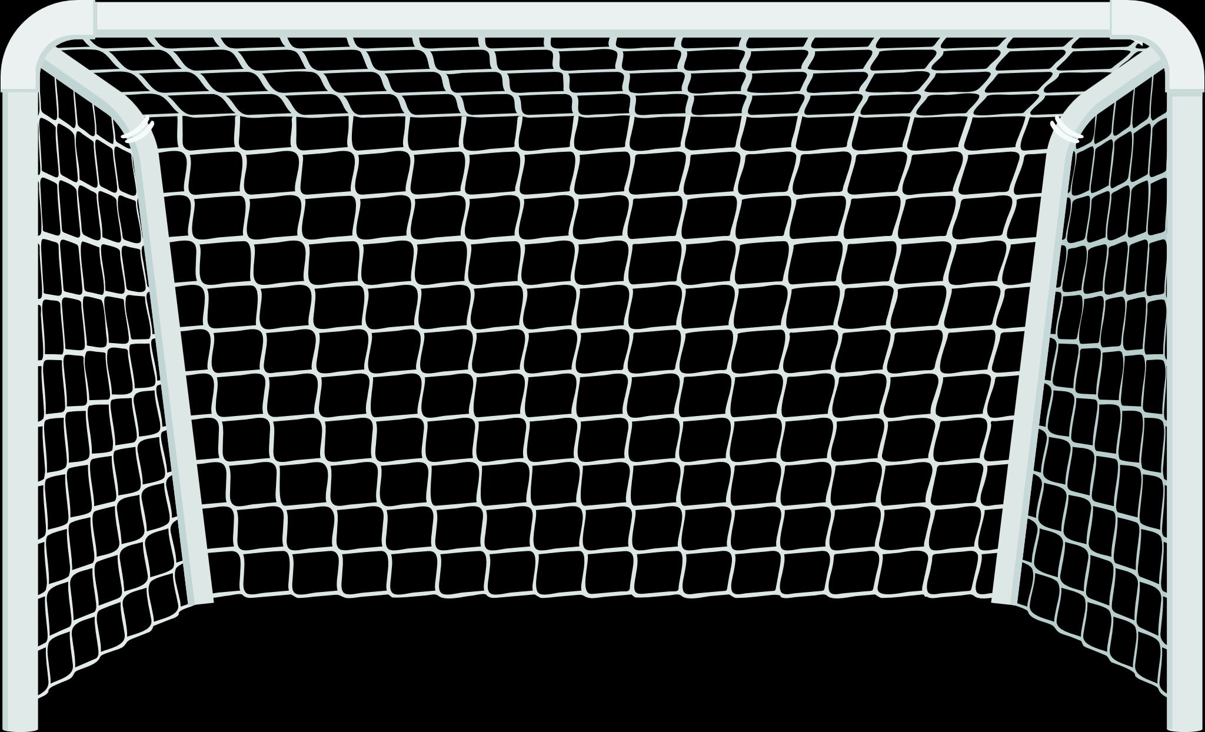

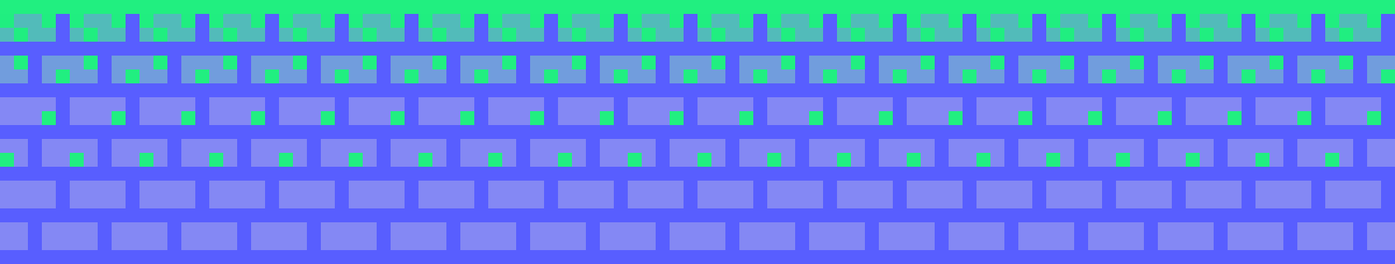
PLAYER 1
NO SCORE
PLAYER 2
PROJECTILE MOTION IN SOCCER!
By: Jinwoo Kim

Slide 2


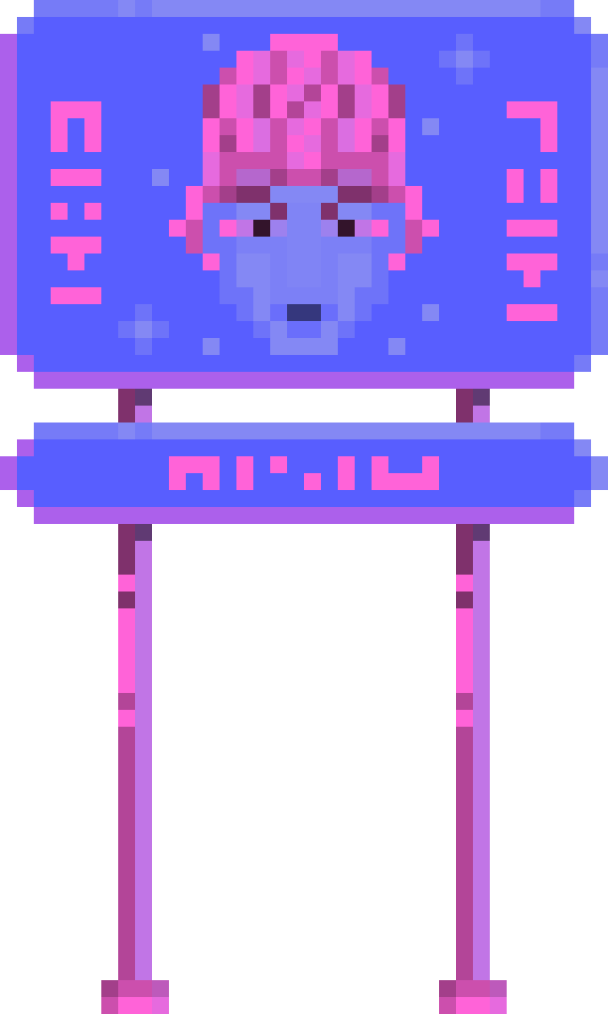
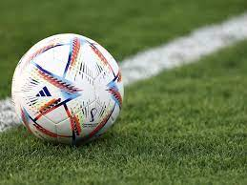


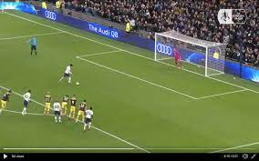
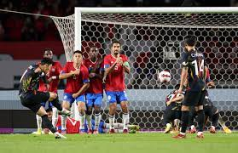
Let's make a game on soccer.
MY IDEAS
Penalty Kick in Soccer sounds good.
Flavio -> Free kicks!
Projectile motion + Better visually!

Slide 3
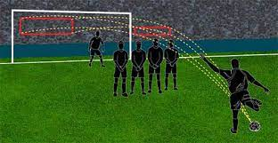
APPLICATION OF PROJECTILE MOTION
Projectile motion determines the trajectory of the ball in soccer free kicks.
Understanding projectile motion helps players calculate the optimal angle and velocity for striking the ball.
Projectile motion allows players to control the flight of the ball, increasing goal-scoring opportunities.

Slide 4






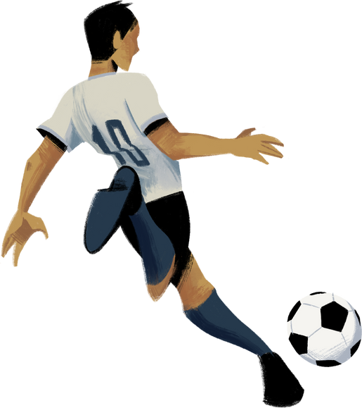
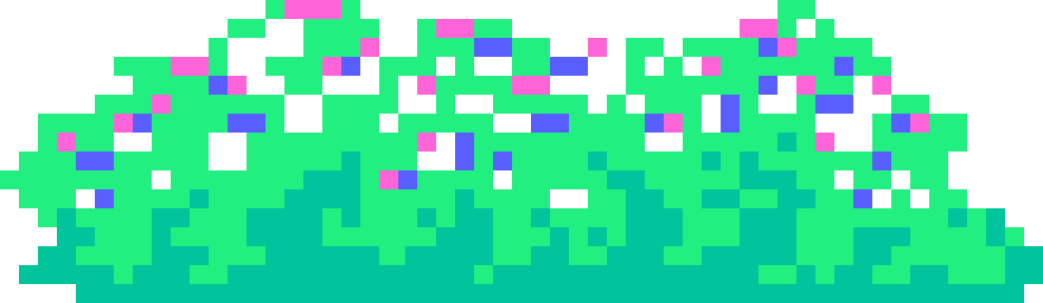
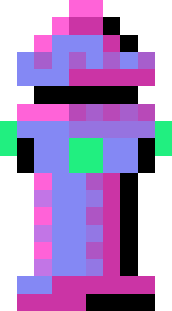
CODES (IMPORTANT) + FORMULAS

Slide 5
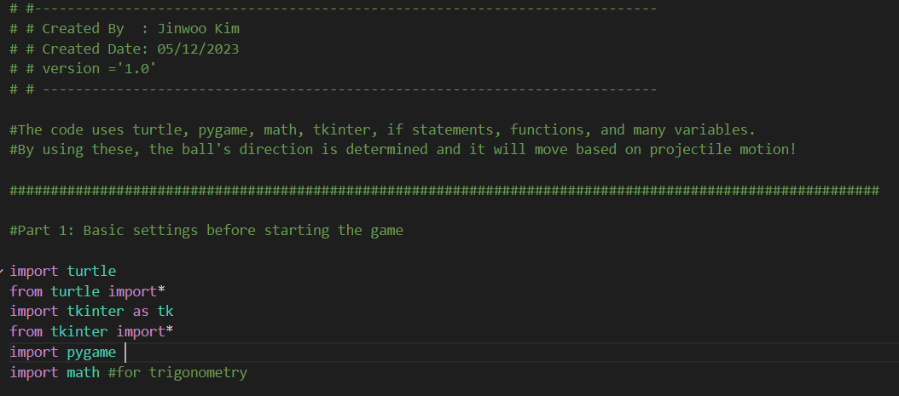
BEGINNING OF THE CODE
Key points: turtle (graphics), tkinter (buttons), pygame (used for time + game better/smoother), math (formulas)

Slide 6
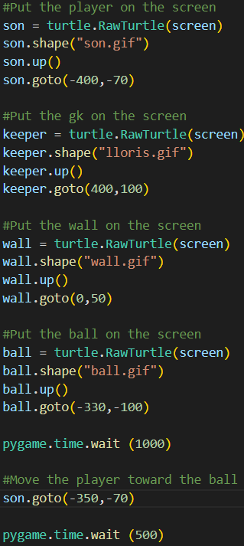
GRAPHICS
Key points:
I used turtle to make better graphics from pictures.
I set these graphics to go to a certain spot.
I use pygame (time) to make the game wait before player start moving to the ball!

Slide 7
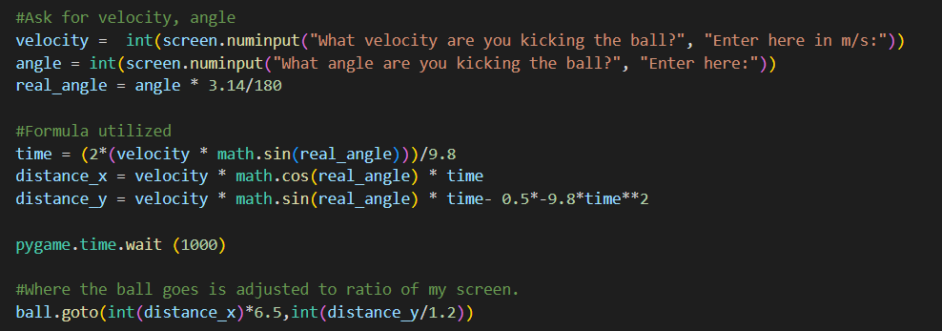
FORMULA!
Key points:
It askes the user for a velocity of the ball in m/s.
It askes the user for the angle of the ball.
I turn the input angle into radian.
It then uses those formula to determine the “final position of the ball."
I adjusted the final distance accordingly to my screen ratio because my screen was very wide --> AJ.

Slide 8
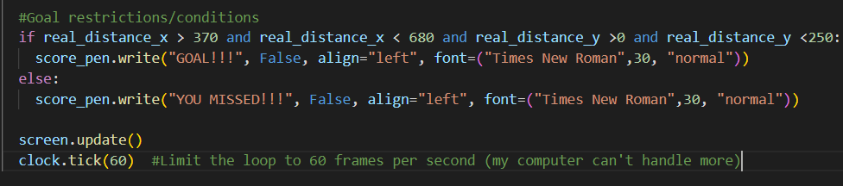
FYI
I also have restrictions set up to determine if user scored or not.

Slide 9
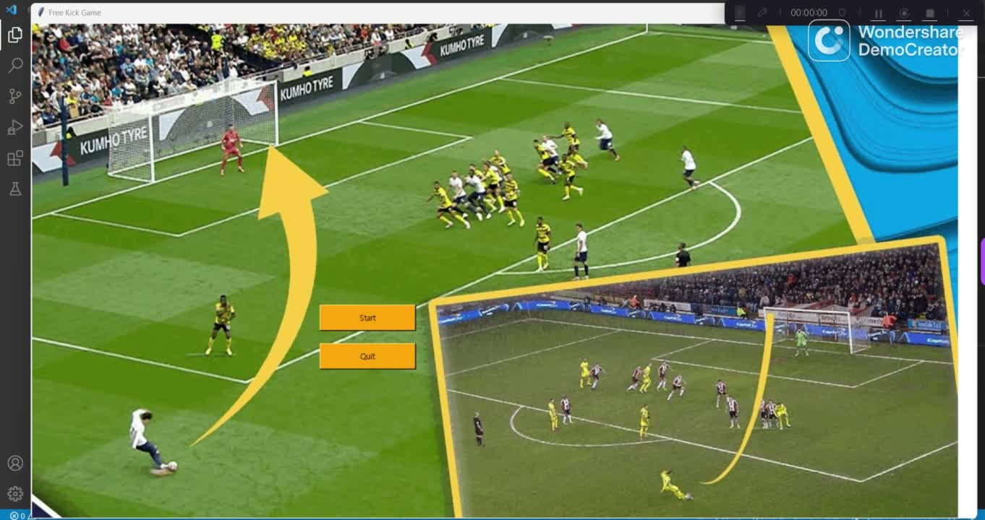
GAMEPLAY 1

Slide 10
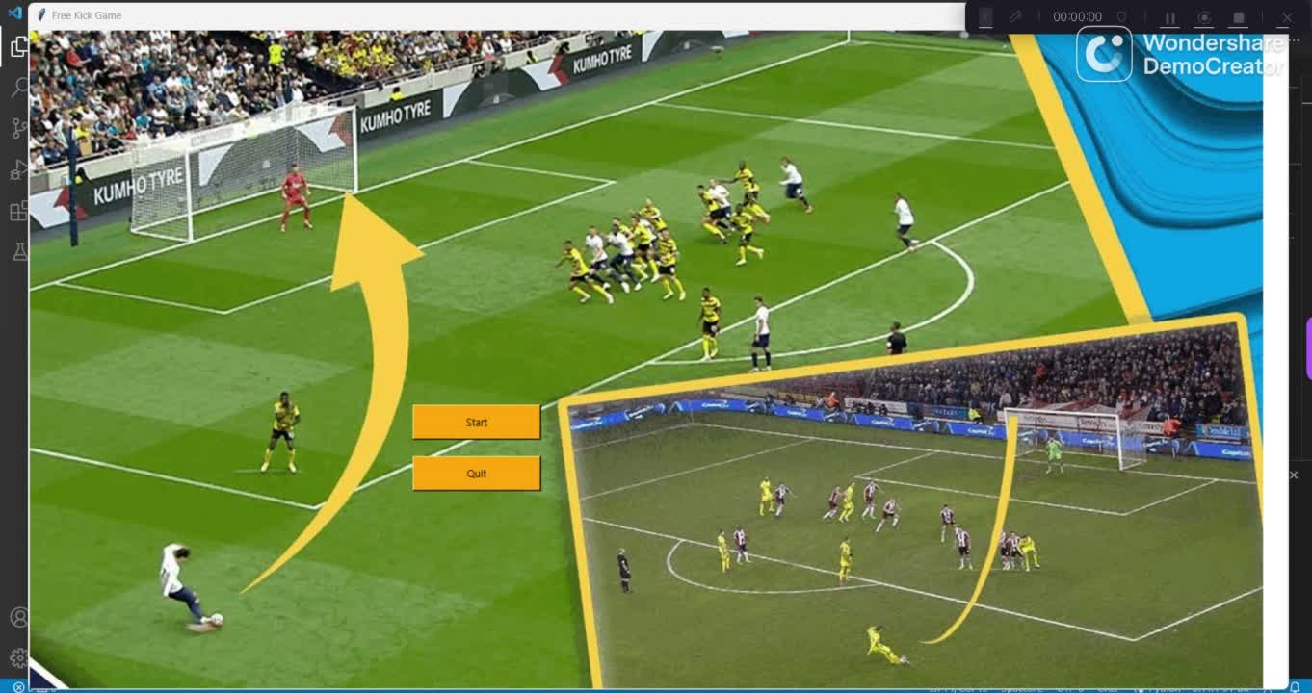
GAMEPLAY 2

Slide 11
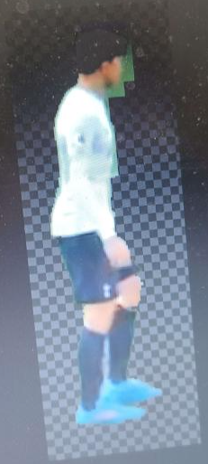
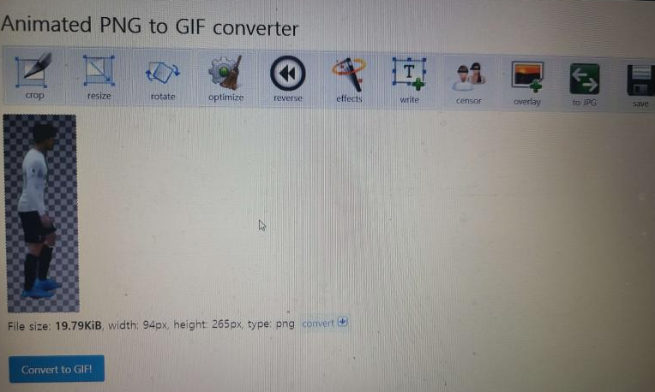
PHOTOSHOPING PROCESS

Slide 12
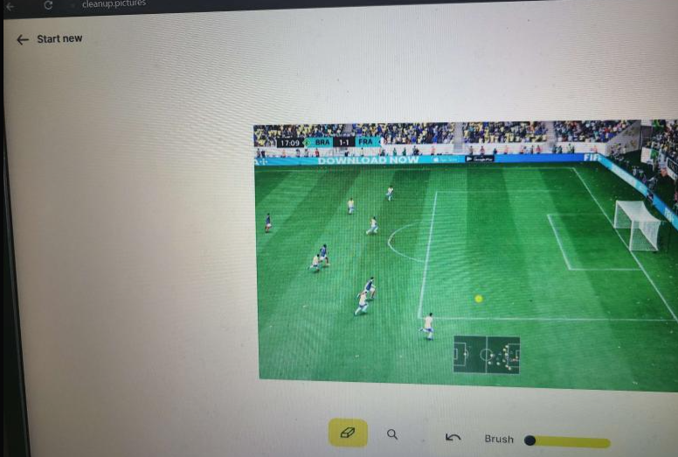
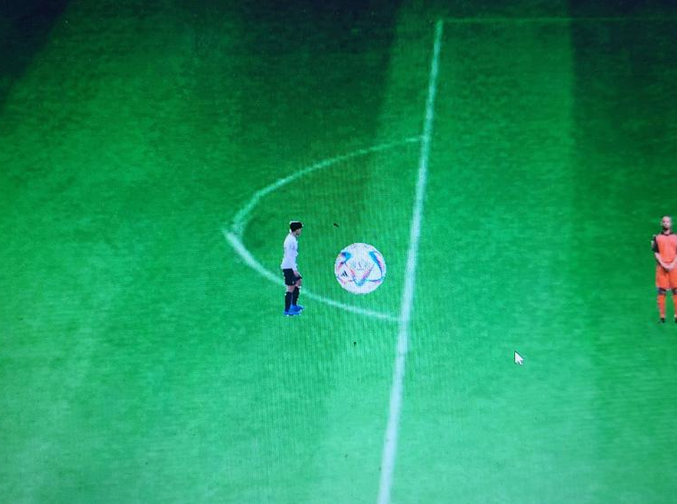
MORE PHOTOSHOS

Slide 13
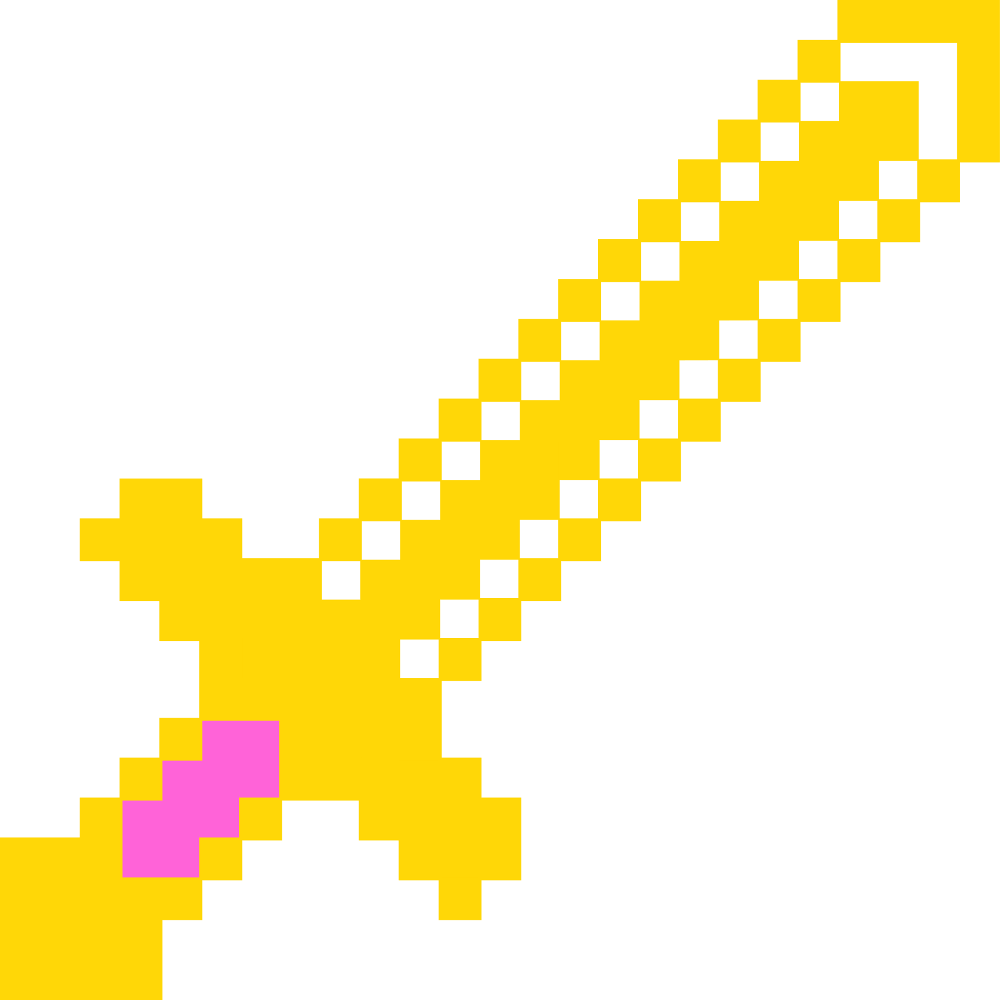



01
07
12
CONCLUSION
The Projectile Motion Free Kick Game successfully combined soccer with projectile motion, offering players and myself an immersive learning experience (significance of angle + velocity).
By integrating physics principles into a game format I also had deeper understanding of how to code in python.

Slide 14
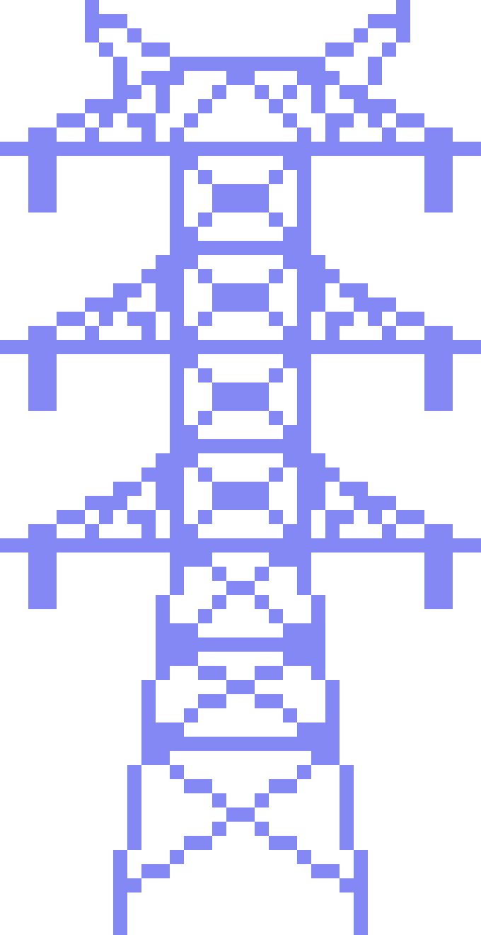
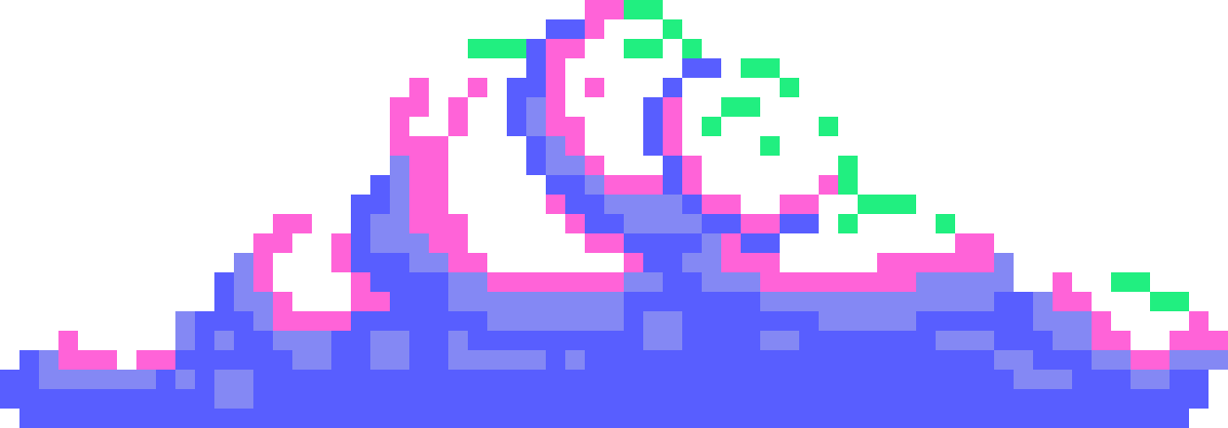
THANK YOU!

